Slide 1
Puzzle Hunt!
SPLASH, Fall 2020

Slide 2
Brief Overview
teams in breakout rooms
selection of 4 math-y puzzles, in roughly increasing difficulty
ask for help!
feel free to jump around puzzles
other puzzle stuff: DP Puzzle Hunt, Puzzle Potluck are good intros
MIT Mystery Hunt is held every January!

Slide 3
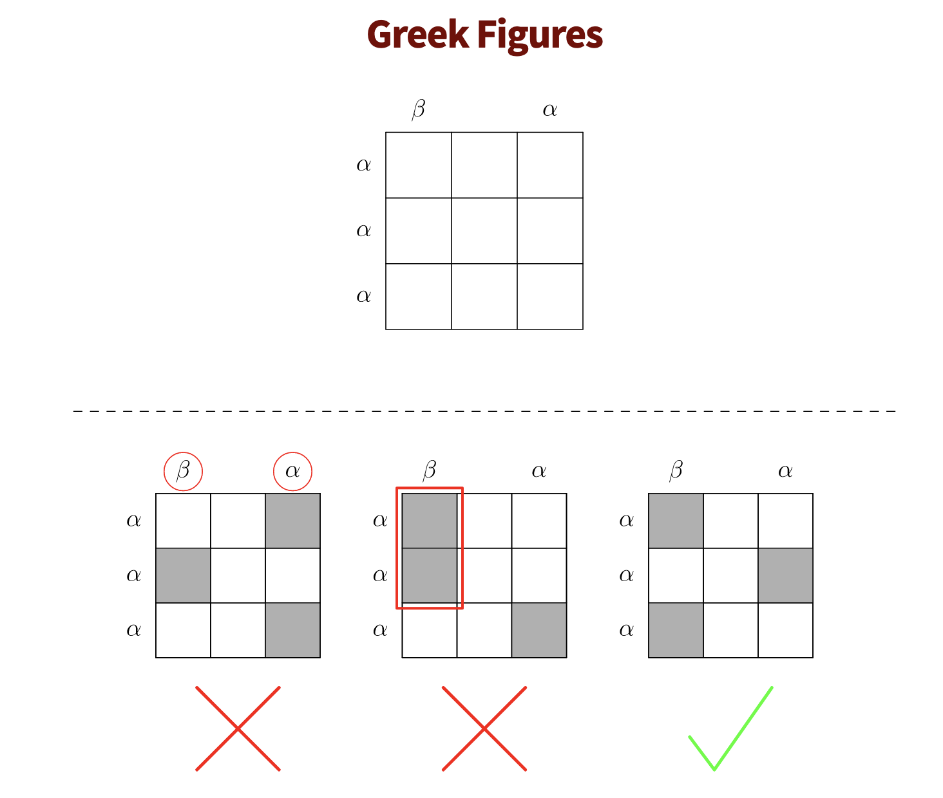
DP Puzzle Hunt

Slide 4
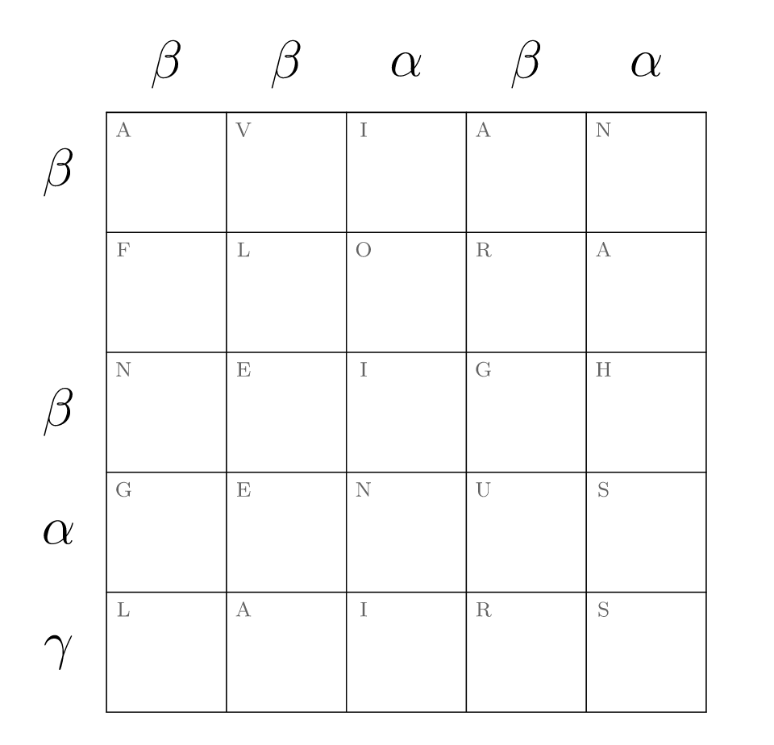
DP Puzzle Hunt
Answer check: https://dp.puzzlehunt.net/post-hunt-solve/greek-figures.html

Slide 5
Stoichiometry 101 (Puzzle Potluck 0.3)
https://puzzlepotluck.com/3/5
(link to puzzle!)

Slide 6
A Wedding Puzzle Hunt Honoring Jackie & Dan

Slide 7
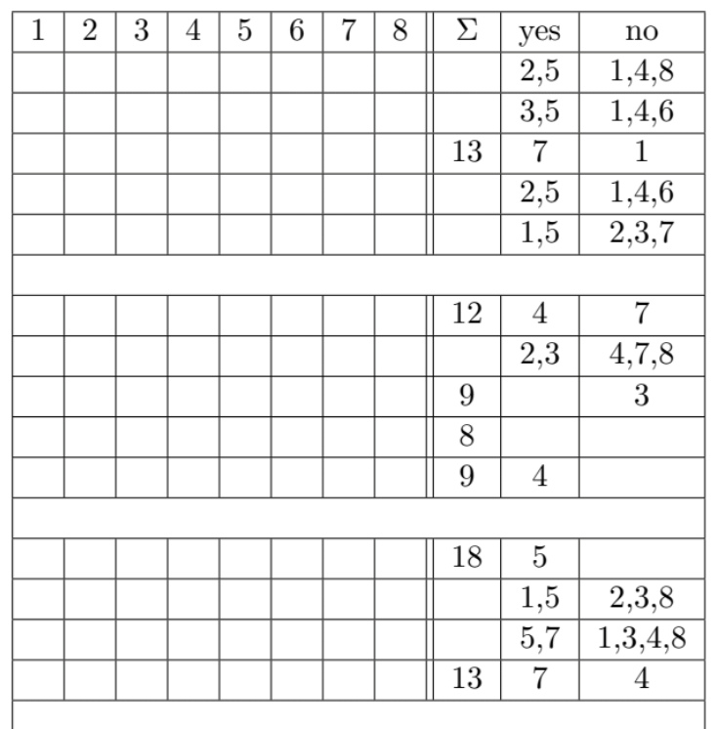
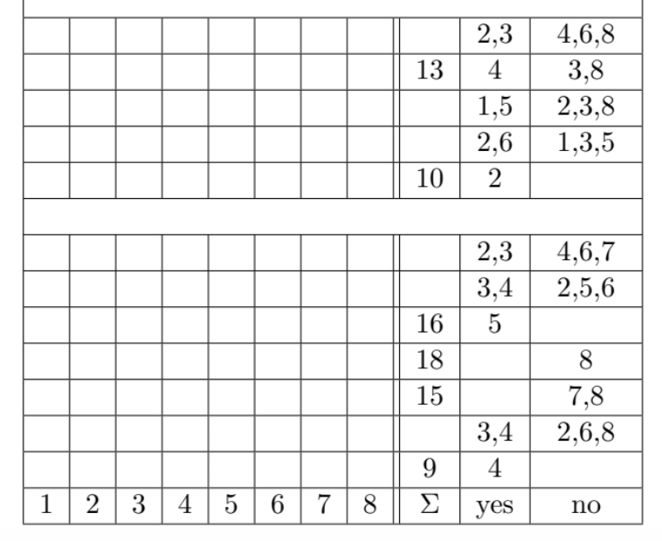
answer is a 3-6 letter word
A Wedding Puzzle Hunt Honoring Jackie & Dan

Slide 8
DP Puzzle Hunt

Slide 9
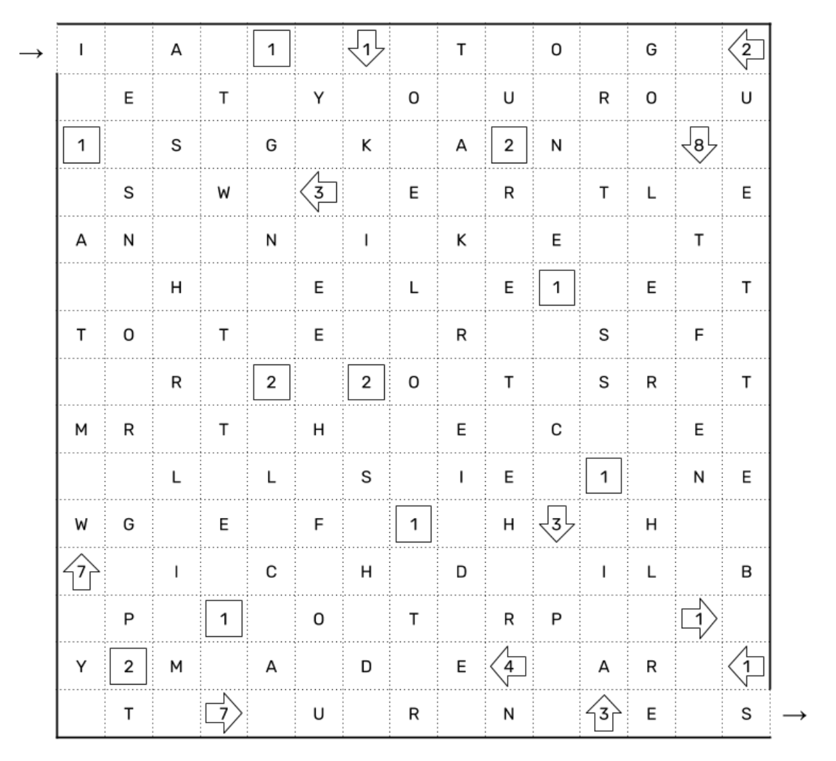
DP Puzzle Hunt
Answer check: https://dp.puzzlehunt.net/post-hunt-solve/danger.html

